Slide 1
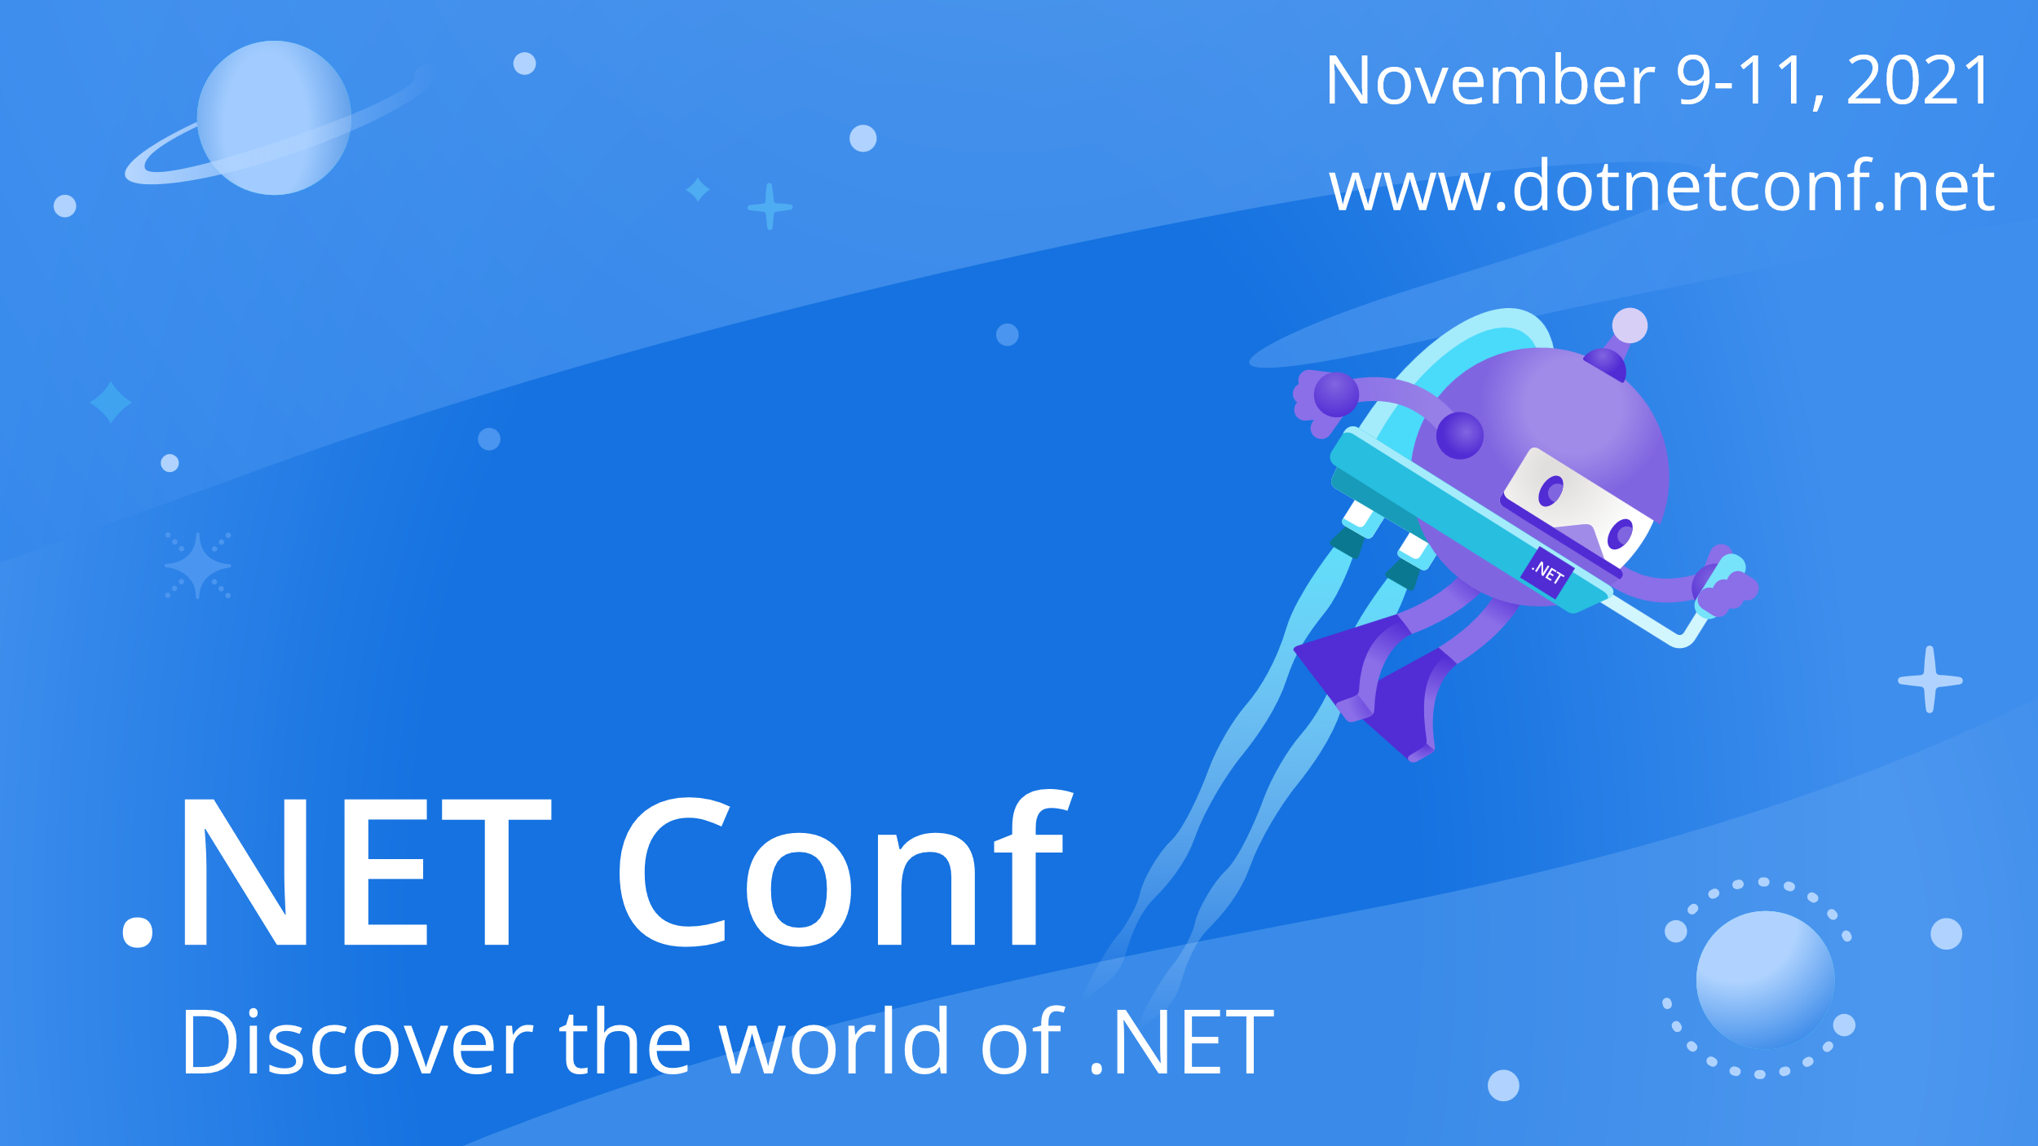

Slide 2




What’s New in EF Core 6
Jeremy Likness and Arthur Vickers

Slide 3

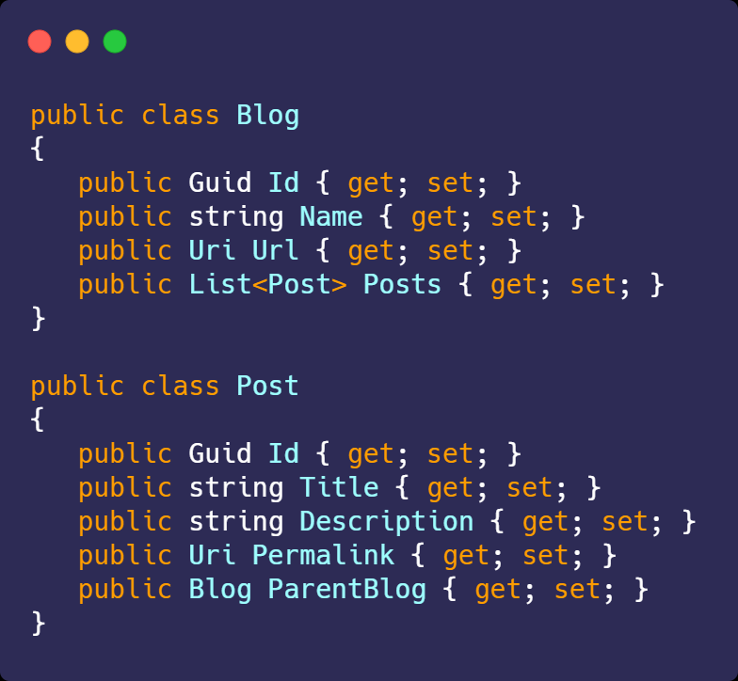
What is EF Core?
I write code.

Slide 4

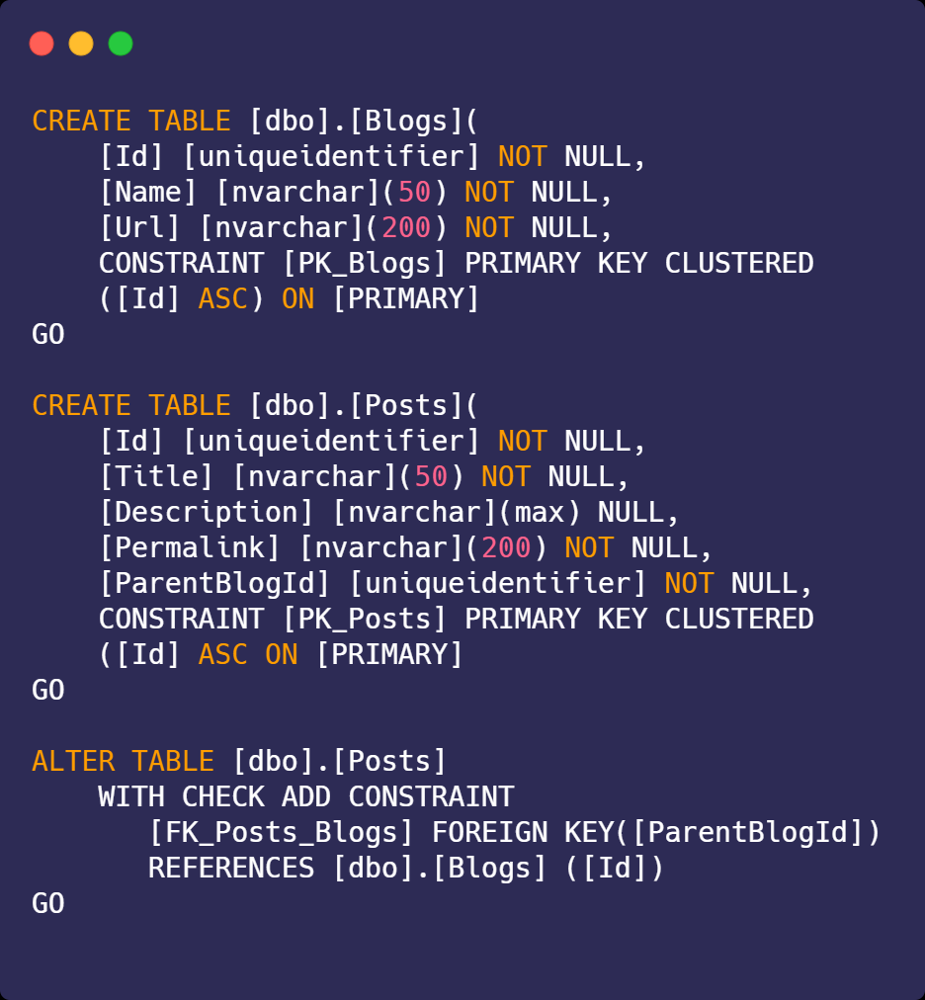
What is EF Core?
I am the master of data.

Slide 5

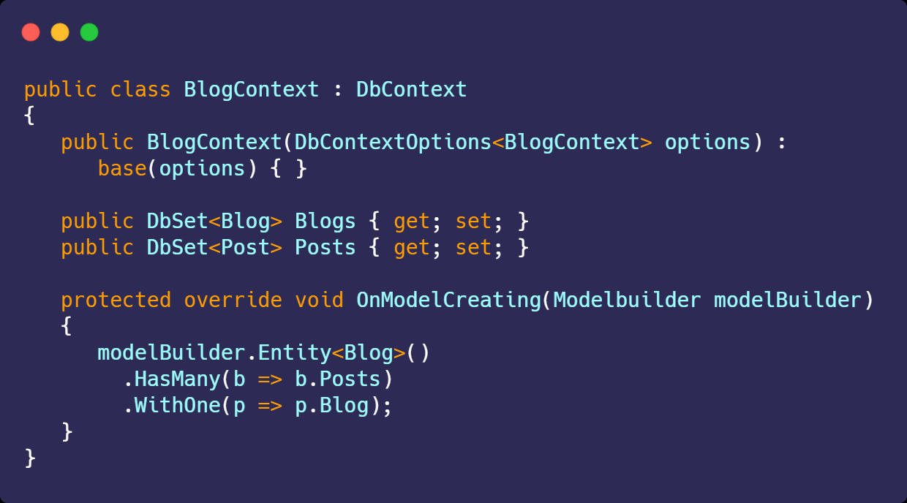
What is EF Core?
I am EF Core. Say “Hello” to my DbContext.

Slide 6







What is EF Core?
Use LINQ to write queries.
Work with your natural domain objects instead of property bags or data tables.
Use a single command to aggregate all changes in a complex object graph.
Fluently configure entity relationships.
Handle optimistic concurrency “out of the box.”
Interface with a consistent API across multiple database backends (SQL, SQLite, MySQL, PostgreSQL, Azure Cosmos DB)

Slide 7
What is EF Core?
... And of course, database schemas do change, so we help manage changes with migrations

Slide 8
What’s New?
SQL Server Temporal Tables
Migration Bundles
Pre-convention Model Configuration
Compiled Models
Performance
Azure Cosmos DB Support
Reverse-Engineering
LINQ Enhancements
New Mapping Attributes
Model Building Improvements
DbContextFactory Improvements

Slide 9
What’s New?
SQL Server Temporal Tables
Migration Bundles
Pre-convention Model Configuration
Compiled Models
Performance
Azure Cosmos DB Support
Reverse-Engineering
LINQ Enhancements
New Mapping Attributes
Model Building Improvements
DbContextFactory Improvements

Slide 10
What’s New?
SQL Server Temporal Tables
Migration Bundles
Pre-convention Model Configuration
Compiled Models
92% Improvement
Performance
Azure Cosmos DB Support
Reverse-Engineering
LINQ Enhancements
New Mapping Attributes
Model Building Improvements
DbContextFactory Improvements
Source: TechEmpower Fortunes Middleware EF benchmark

Slide 11
What’s New?
SQL ervTemporal Tables
Migration Bundles
Pre-convention Model Configuration
Compiled Models
Compiled Models
Performance
Azure Cosmos DB Support
Reverse-Engineering
LINQ Enhancements
New Mapping Attributes
Model Building Improvements
DbContextFactory Improvements
Source: TechEmpower Fortunes Middleware EF benchmark

Slide 12
Compiled Models
dotnet ef dbcontext optimize --output-dir MyCompiledModels --namespace MyCompiledModels

Slide 13
Compiled Models

Slide 14
Demo: Temporal Tables Migration Bundles Pre-convention Model Building New Mapping Attributes
⌚🏎️Time travel with LINQ.

Slide 15
Demo: 🌍Azure Cosmos DB
Simple. Easy. Fast.

Slide 16

Thanks for joining!
What’s new in EF Core 6.0?
https://aka.ms/efcore-whatsnew60
EF Core Community Standups
https://aka.ms/efstandups @JeremyLikness | @AjcVickers

